Slide 1
Programming
Techniques
COSC1284/2010
Tutorial 5

Slide 2
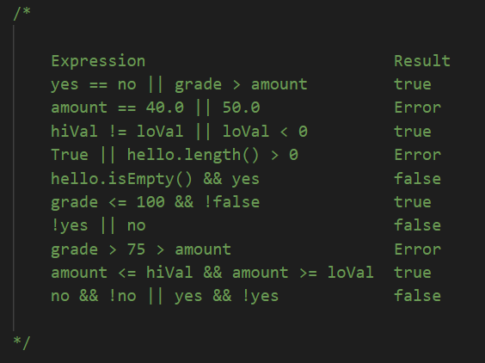
Exercise 5.1 Solution

Slide 3
Agenda
Tutorial/Lab
Read chapter 6 from the textbook
Discuss the concepts with your tutor and fellow classmates
Complete chapter 6 - Exercises 1 - 3
Attempt on your own
Complete chapter 6 - Exercises 4 - 6
Note: Please refer to tutorial 4 for online instructions.

Slide 4
Loops and Strings
We come to the point where need to repeat our code, such as sorting, search, displaying a picture (number of pixels), showing a movie (number of frames) and many more examples.
Essentially, there are three basic and common ways to loop our code, the for loop, the while loop and the do while loop.
The main difference between the loops; the for loop generally loops with a known end point, where a while loop has an unknown endpoint.
The majority of the programs that we have looked at involves numbers, such as conversions of temperatures or dates, it would be advantageous if we could representative text too.
We accomplish this by using a data type called String, which is basically made up of a series of characters as well as a number of methods that we can use with Strings.

Slide 5
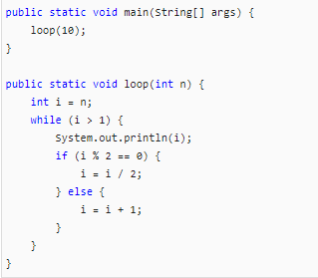
Exercise 6.1
Draw a table that shows the value of the variables i and n during the execution of loop. The table should contain one column for each variable and one line for each iteration.
What is the output of this program?
Can you prove that this loop terminates for any positive value of n?

Slide 6
Exercise 6.2
Let’s say you are given a number, a, and you want to find its square root. One way to do that is to start with a rough guess about the answer, x0, and then improve the guess using this formula:
x1 =(x0 + a/x0) / 2
For example, if we want to find the square root of 9, and we start with x0 = 6, then x1 = (6 + 9/6) / 2 = 3.75, which is closer. We can repeat the procedure, using x1 to calculate x2, and so on. In this case, x2 = 3.075 and x3 = 3.00091. So it converges quickly on the correct answer.

Slide 7
Exercise 6.2 (cont)
Write a method called squareRoot that takes a double and returns an approximation of the square root of the parameter, using this technique. You should not use Math.sqrt.
As your initial guess, you should use a/2. Your method should iterate until it gets two consecutive estimates that differ by less than 0.0001. You can use Math.abs to calculate the absolute value of the difference.

Slide 8
Exercise 6.3
One way to evaluate exp(−x2) is to use the infinite series expansion:
exp(−x2) = 1 − x2 + x4/2 − x6/6 + …
The ith term in this series is (−1)i x2i / i!. Write a method named gauss that takes x and n as arguments and returns the sum of the first n terms of the series. You should not use factorial or pow.

